Slide 1

CONSUMER BEHAVIOR ANALYTICS
Hemanth Matta
CSDA 6010 DATA ANALYTICS PRACTICUM

Slide 2
INTRODUCTION
Company Overview :
Shop-Smart sells premium food and drinks
Has many customers with different shopping styles
Collects info like age, shopping habits, and past offers
Goal:
Understand customer needs
Group similar customers together
Send the right offers to the right people

Slide 3
BUSINESS PROBLEM AND GOALS
Business Problem:
Shop-Smart cannot group customers based on shopping habits, making it hard to send personalized offers.
marketing campaigns often miss the right audience, wasting budget and lowering ROI.
Business Goal:
Understand customer groups to create more focused and engaging marketing campaigns.
Predict which customers are likely to respond, helping reduce costs and increase sales.

Slide 4
ANALYTICAL GOAL AND APPROACH
Analytical Goal:
Group customers based on shopping behavior and preferences using clustering.
Predict which customers are likely to respond to marketing campaigns using classification.
Analytical Approach:
For Segmentation (Clustering):Clean and prepare customer data, then group similar customers.Analyze each group to design targeted marketing strategies.
For Prediction (Classification):Use past campaign data to build a model that identifies responders.Apply the model to send offers to the right custom

Slide 5
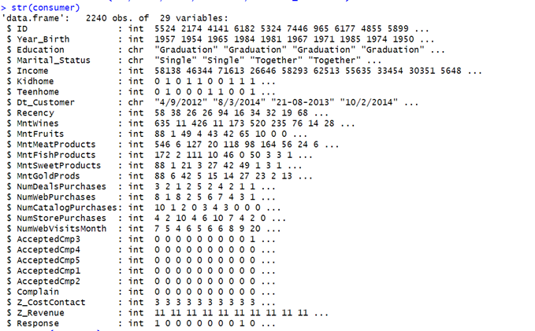
DATA EXPLORATION AND PREPROCESSING
The shopsmart provided the data set having 2240 records with 29 attributes

Slide 6
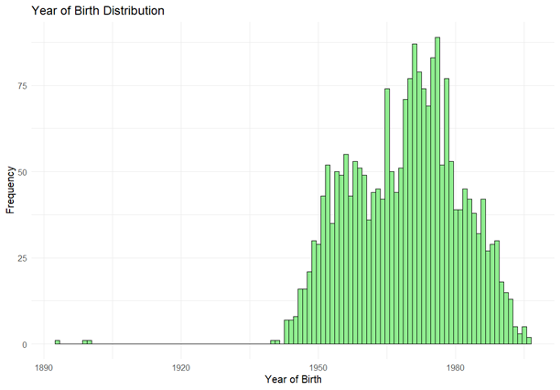
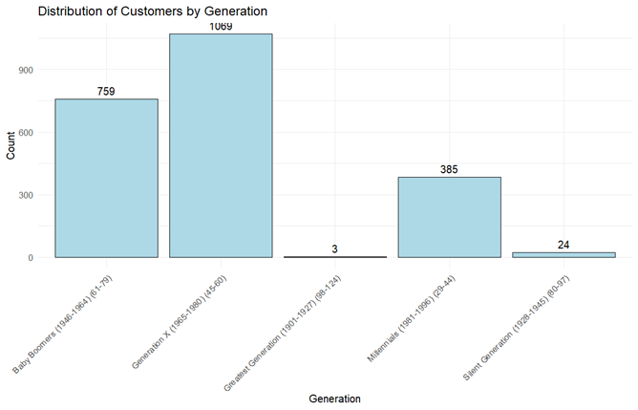
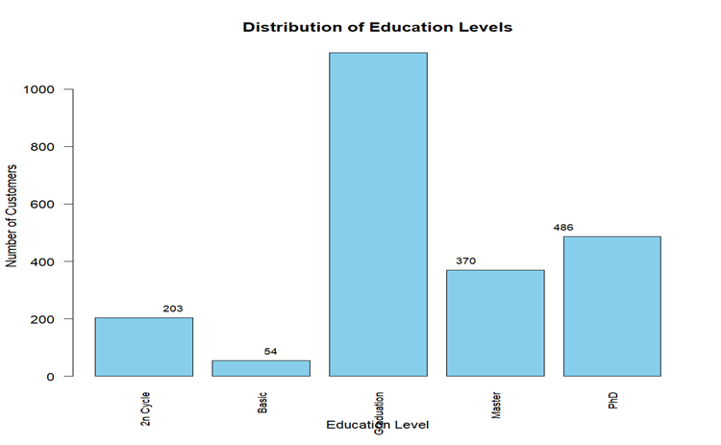
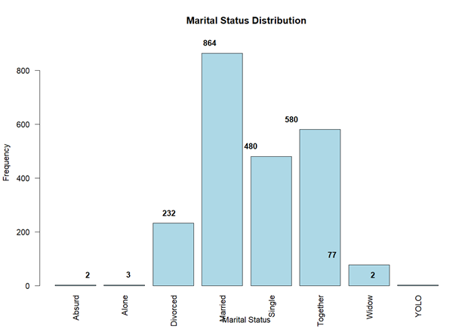
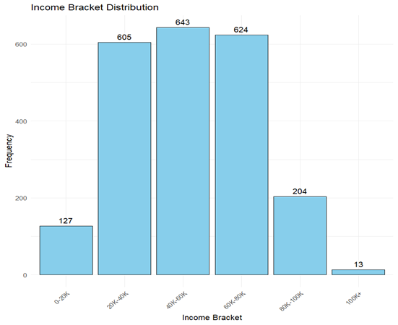
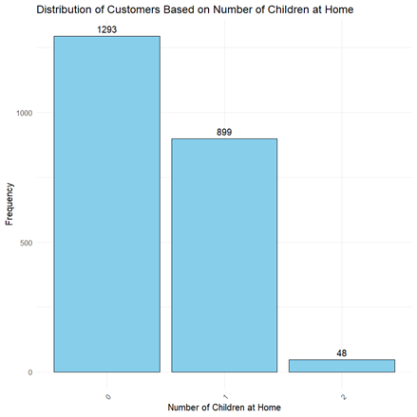
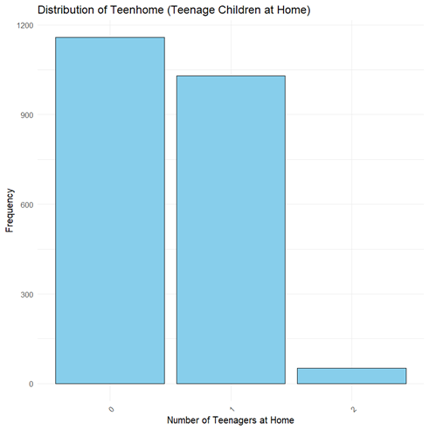
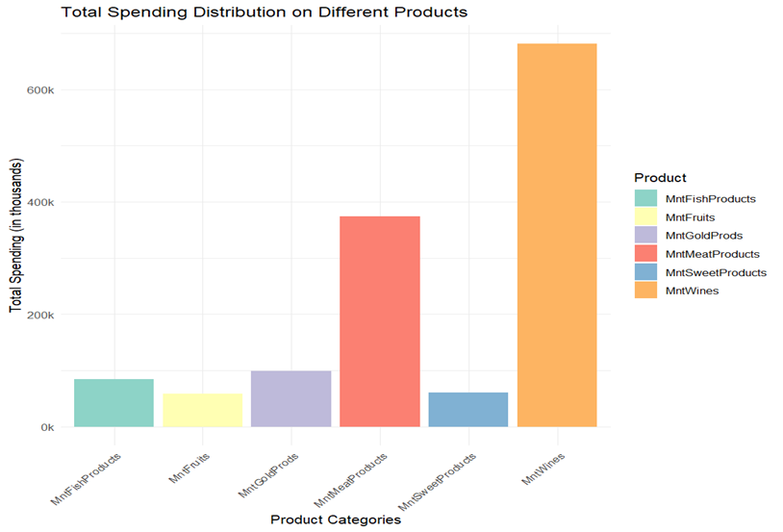
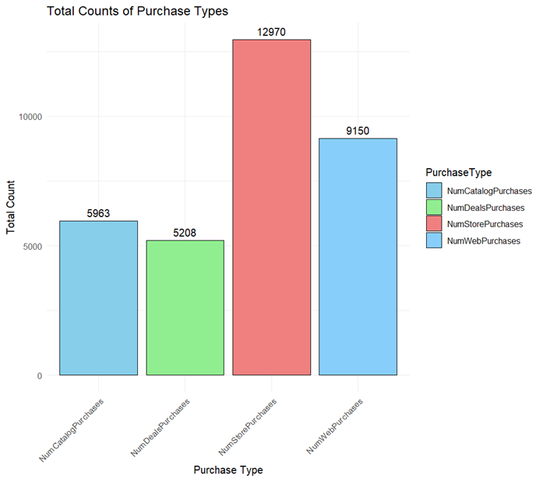

Slide 7
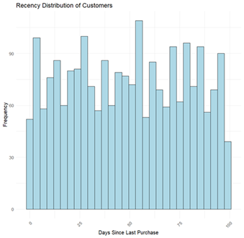
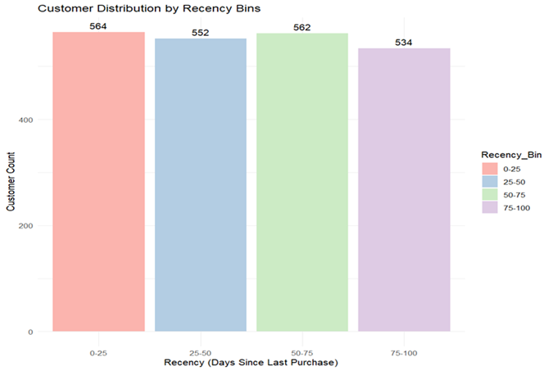
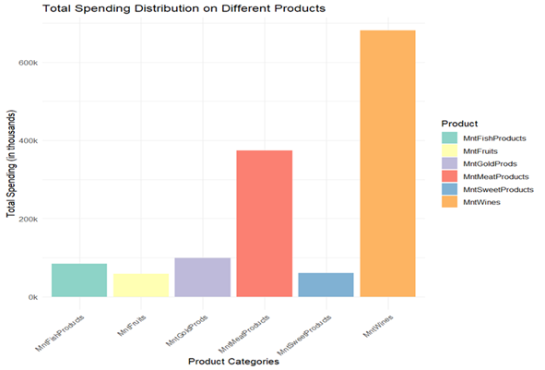
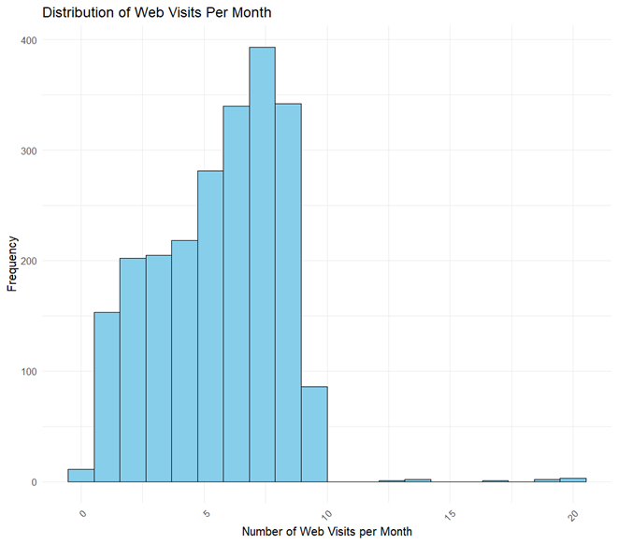
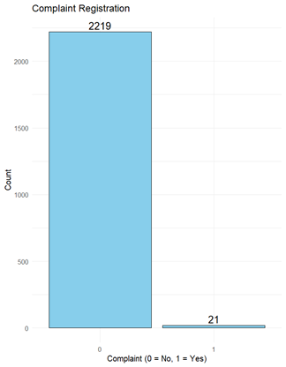
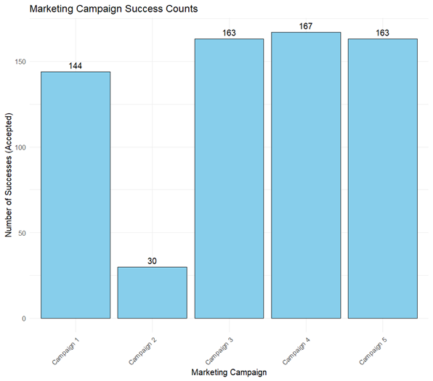
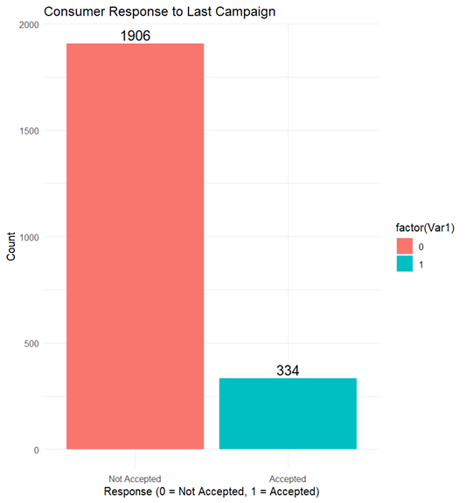

Slide 8
DATA TRANSFORMATION
1.Age & Generation:
Converted Year_Birth into Age
Grouped into generations: Baby Boomers, Gen X, Millennials, Silent Gen
2. Income Grouping
Transformed Income into Income_bracket (20K–40K, 60K–80K)
Simplified analysis by income level and removed missing values
3. Recency Binning:
Converted Recency into Recency_Bin (0–25, 25–50)
Helped identify active vs. inactive customers
4. Education Simplification:
Merged 2nd Cycle with Master for consistency in education levels
5. Target Variable Creation:
Created Target_Response to mark campaign responders (1) vs. non-responders (0)Combined results from all campaign response fields

Slide 9
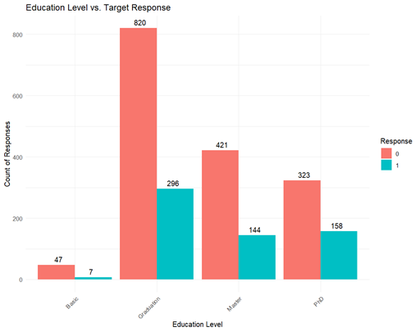
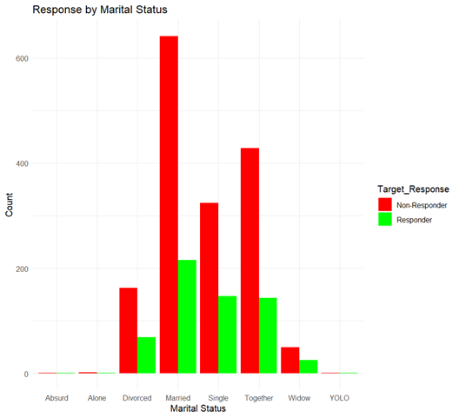
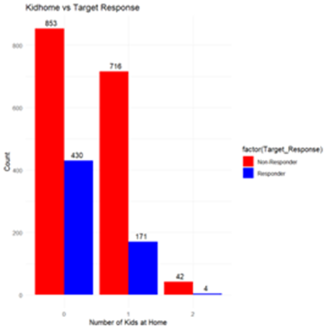
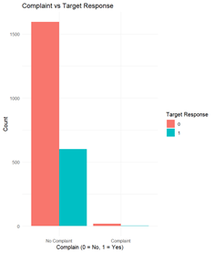
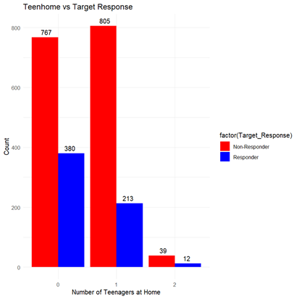
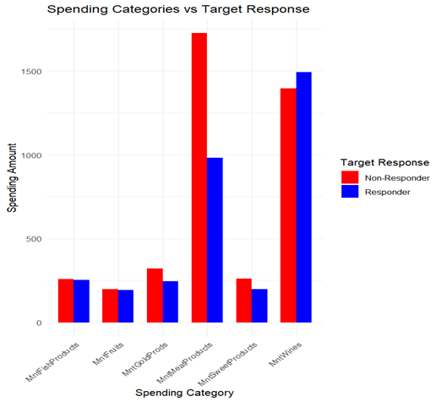
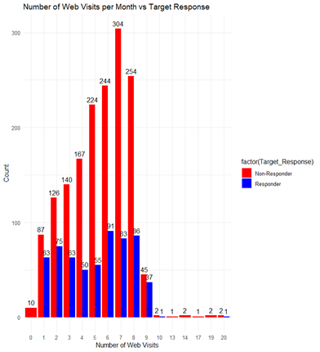

Slide 10
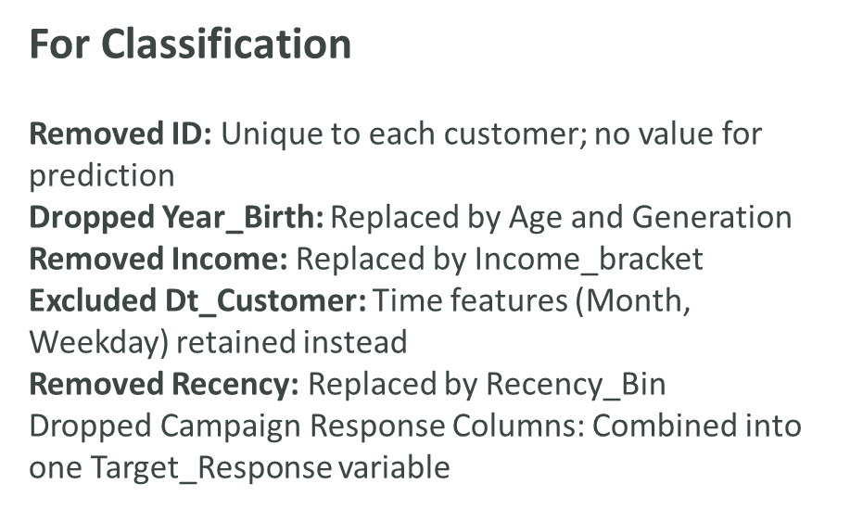
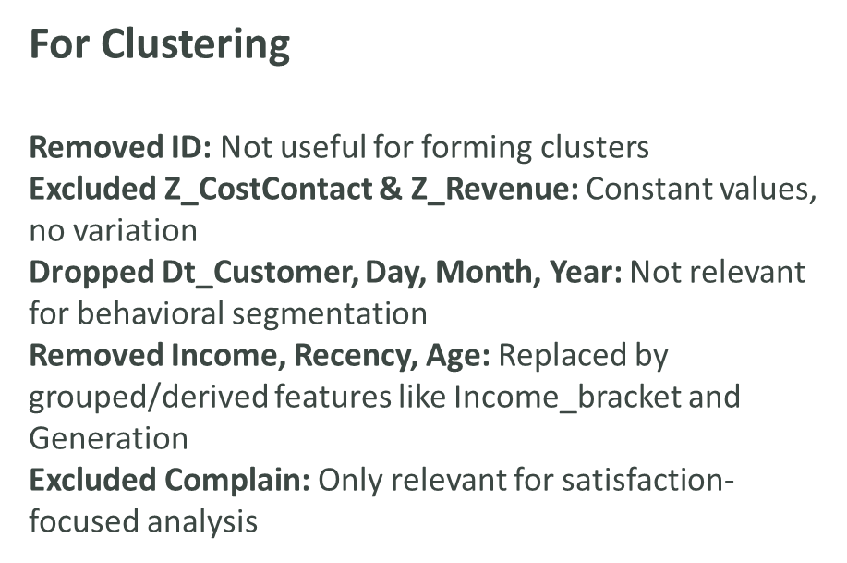
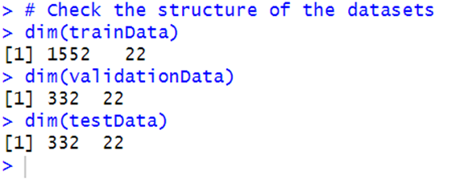
Dimension Reduction:
Data Partition:

Slide 11
Model selection
Aspect | K-Means Clustering | Hierarchical Clustering
Segment Clarity | - Created 3 clear groups: high, mid, low value - Easy to tell who is VIP, average, or low spender | - Groups had mixed behavior - Hard to label or understand who belongs where
Actionability | - Easy to connect each group to a marketing plan - Example: VIPs = loyalty offers, low-value = awareness emails | - Some clusters were confusing - Example: High spenders who didn’t respond—hard to know how to market to them
Mid Spender Group | - Clearly separated mid-tier customers - Great for upselling or bundle offers | - Not clearly defined - Some had mixed behavior, so it was hard to design focused campaigns
Engagement Match | - High spenders also responded to campaigns - Perfect for premium targeting and special promotions | - Some big spenders didn’t respond - Risk of wasting money on people who won’t engage

Slide 12
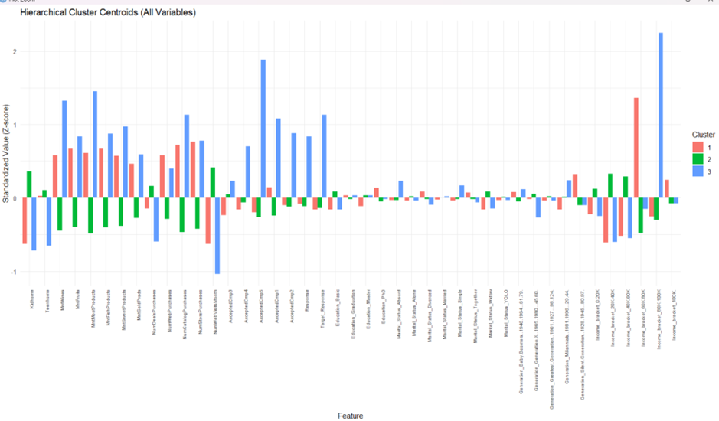

Slide 13
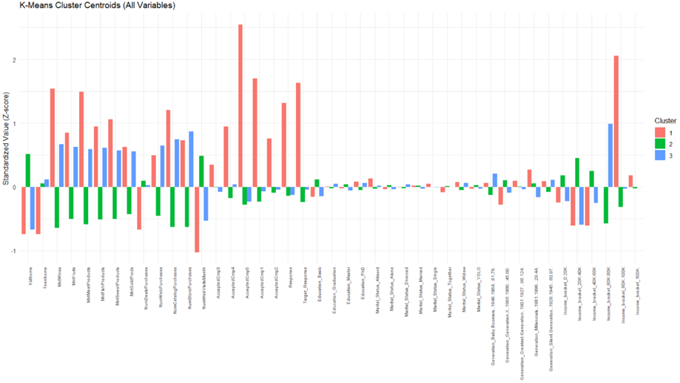

Slide 14
Model selection
Metric | Logistic Regression | Random Forest
Accuracy | 0.7519 | 0.8253
Kappa | 0.2777 | 0.4970
Sensitivity (Recall) | 0.3333 | 0.5556
Specificity | 0.9084 | 0.9124
Positive Predictive Value (Precision) | 0.5400 | 0.6716
Negative Predictive Value | 0.8085 | 0.8642
Balanced Accuracy | 0.6208 | 0.7340

Slide 15
Model improvement
For classification:
Lowered the prediction threshold from 0.5 to 0.4 to better identify customers who are likely to respond to campaigns.
For Clustering
Tested different nstart values (10–100) in K-Means; results stayed consistent, showing the clustering solution is stable and reliable.

Slide 16
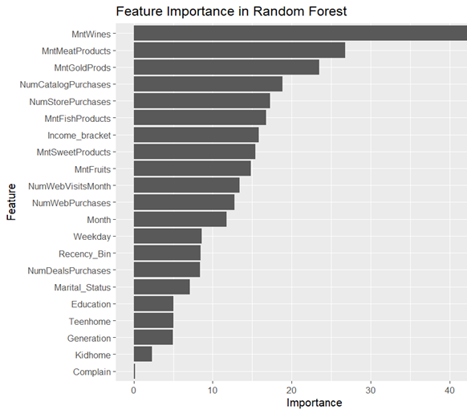
conclusion
Model Used:
Random Forest
Key Findings:
High spending on wine, meat, and gold = more likely to respond
Catalog and store purchases signal higher engagement
Income & web visits moderately influence response
Demographics, kids at home, and complaints had minimal impact

Slide 17
Conclusion
Segment | Traits | Marketing Strategy
High-Value Loyalists | High spend, educated, campaign responsive | VIP perks, loyalty programs, exclusive deals
Mid-Tier Multi-Channel Shoppers | Moderate spenders, open to engagement | Upselling, seasonal offers, multi-channel rewards
Low-Spending Browsers | Low spend, low response, price-sensitive | Awareness campaigns, discounts, first-time buyer deals

